Slide 1

EF core
New orm on the block
Notes:
1

Slide 2
How cool EF Core is?
What is EF Core?
What’s new in model mapping?
How code first migrations works now?
Are queries any better?
Should I move from EF6 to EF Core?

Slide 3
What is ef core?
„Entity Framework (EF) Core is a lightweight, extensible, and cross-platform version of the popular Entity Framework data access technology.”
Microsoft

Slide 4
WHY EF CORE AND NOT EF7?
Cross-platform
Written from the scratch (latest version: almost 2.1)
Improved concepts known from EF6
Implemented new features
Emphasis on performance optimization
[Not yet] all features implemented

Slide 5

Model mapping

Slide 6
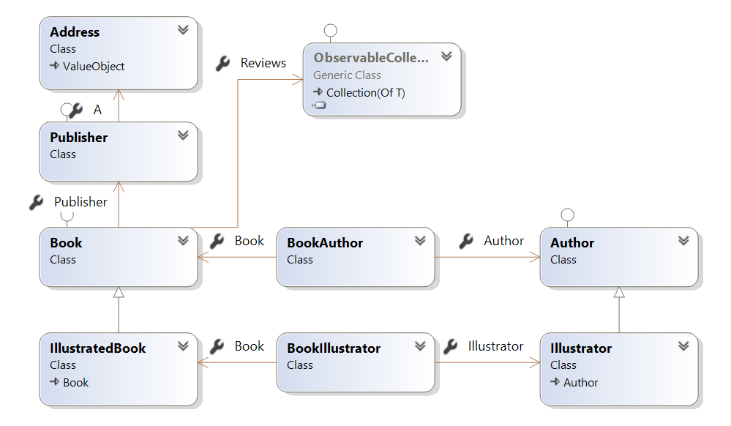
Model

Slide 7
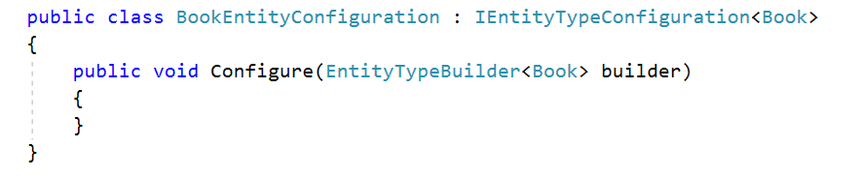
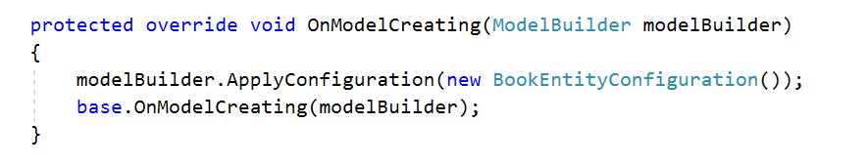
Entity configuration
Implement IEntityTypeConfiguration interface
Use entity configuration class in DBContext

Slide 8
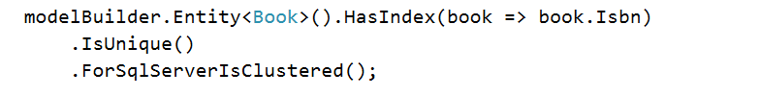
Entity Keys & Indexes
Primary key
Alternate key
Index

Slide 9
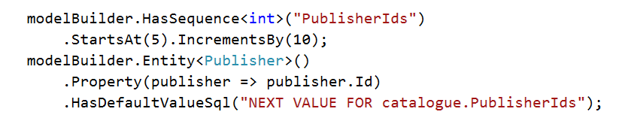
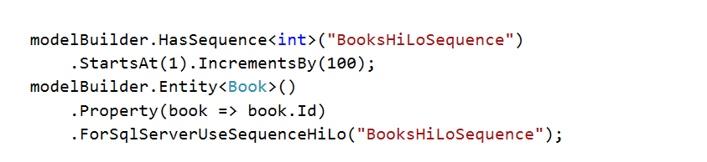
Sequences
SQL Sever Sequence
HiLo Sequence

Slide 10
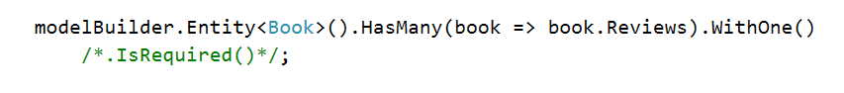
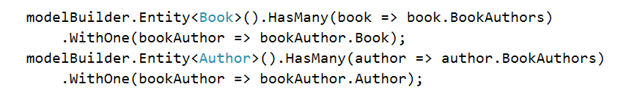
relationships
One-to-many
Many-to-one
Many-to-many (with join entity ☹)

Slide 11
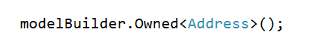
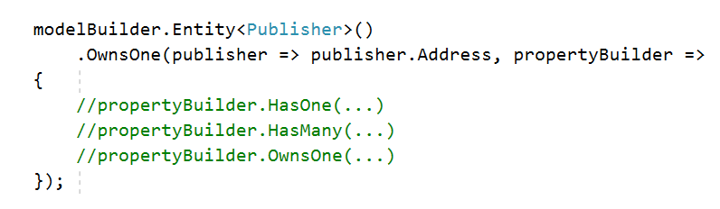
Owned types – former Complex types
Global mapping
Entity mapping

Slide 12
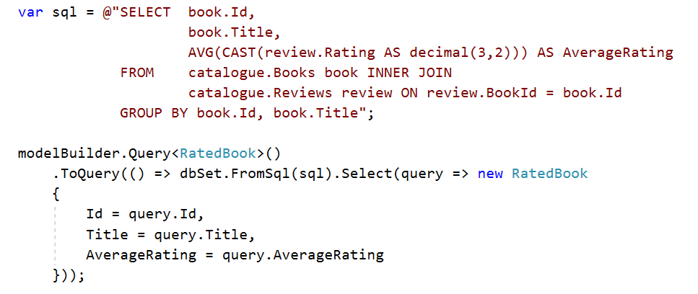
Query types – NO primary key required
Raw SQL
View

Slide 13
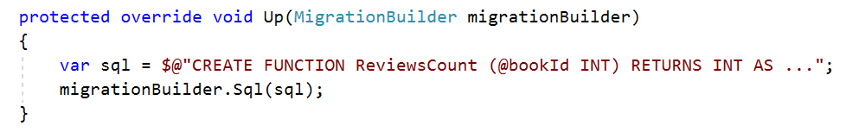
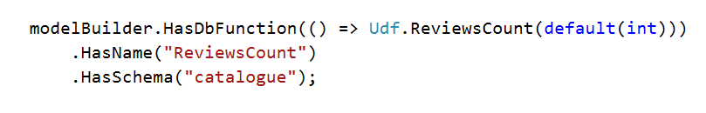
DB Functions (Scalar)
Step 1
Step 2
Step 3

Slide 14
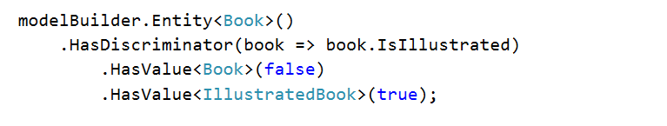
Inheritance – tph only
Define discriminator
Define base class

Slide 15
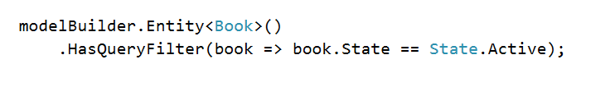
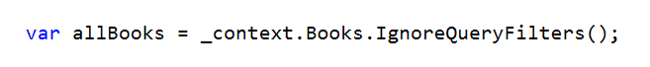
Query filtering
Map
Ignore

Slide 16
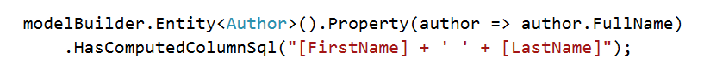
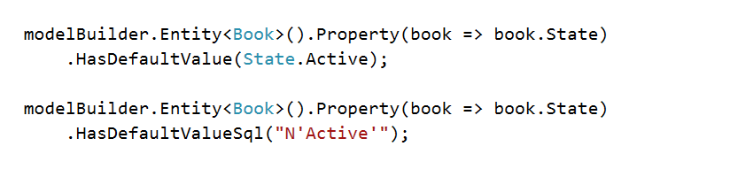
DB Generated values
Computed columns
Default values

Slide 17
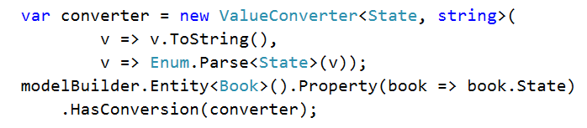
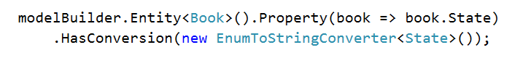
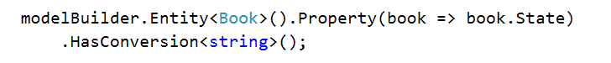
Value conversion
Value converter
Built-in converter
Pre-defined convertion

Slide 18
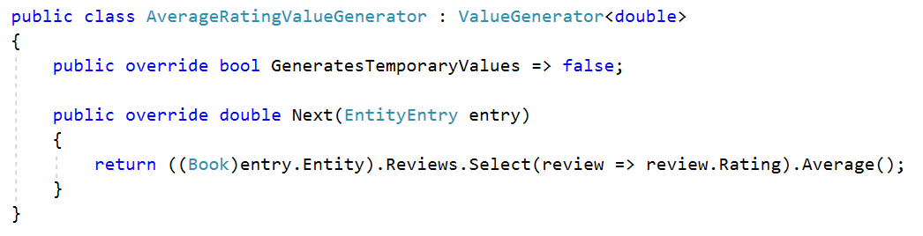
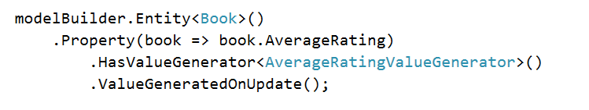
Value generation
Define value generator
Mapping

Slide 19
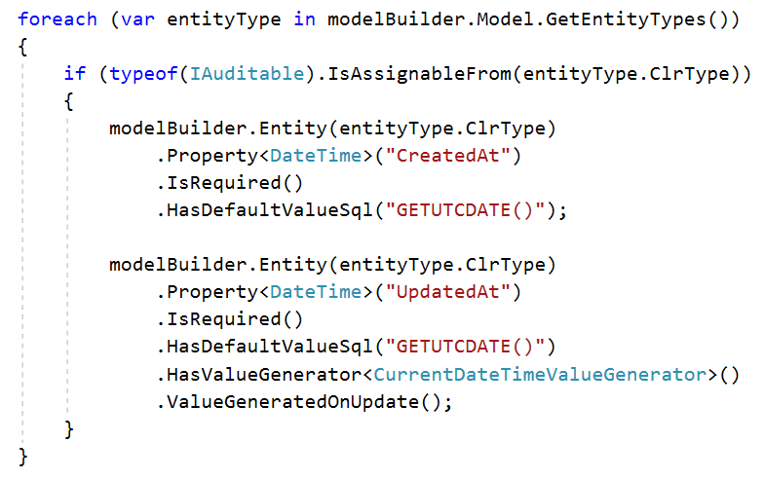
Shadow properties

Slide 20
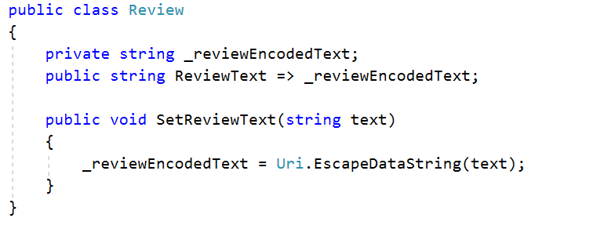
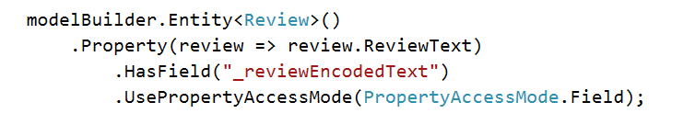
Field Mapping
Field in entity class
Field mapping

Slide 21
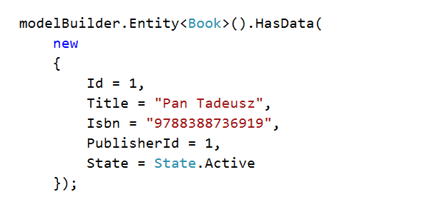
Data SEEDING
Defined as a part of entity mapping
Anonymous objects can be used
Generated as part of migrations

Slide 22

Code first Migrations

Slide 23
CODE FIRST migrations – NEW STUFF
Support for both PS functions and dotnet CLI commands
Possibility of creating a separate project for migrations
Possibility of changing migrations history table structure

Slide 24
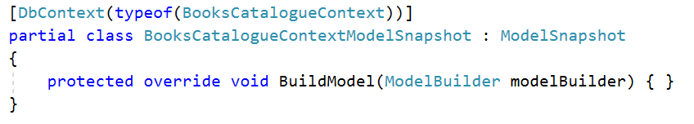
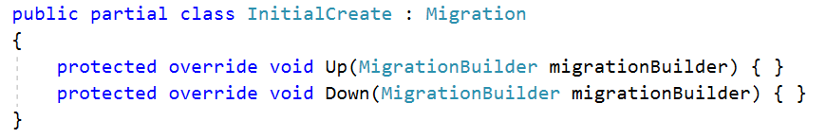
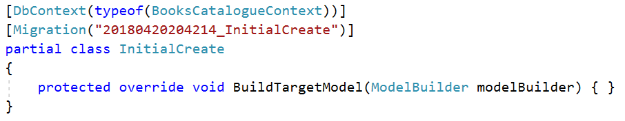
Code first migrations
Model snapshot
Migration file
Designer

Slide 25
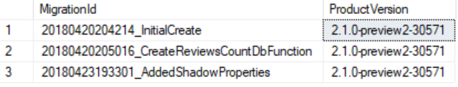
Code first migrations
Migrations history - stored in __EFMigrationsHistory table
Migrations should be removed explicitly with Remove-Migration command

Slide 26

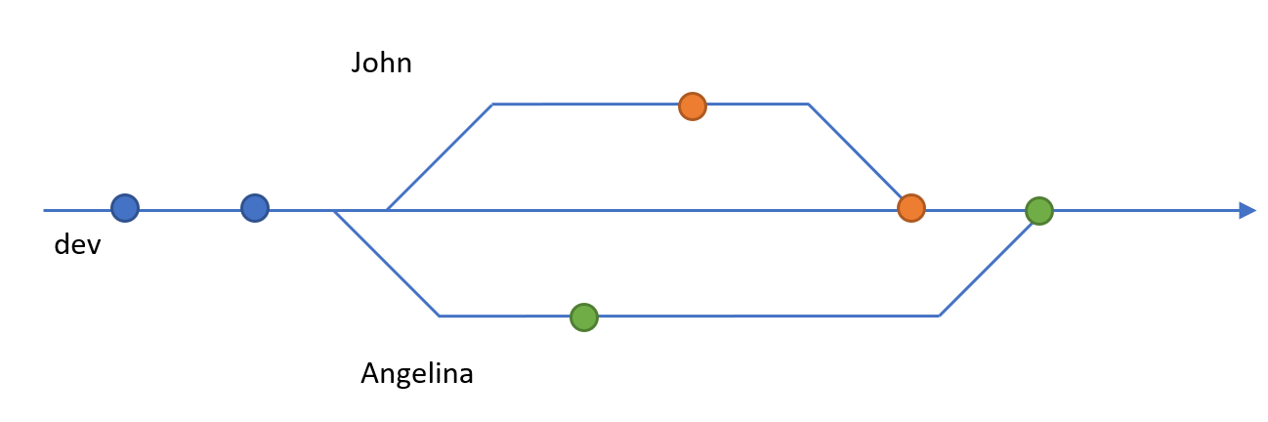
PROBLEM: migrations in team environments

Slide 27

Queries

Slide 28
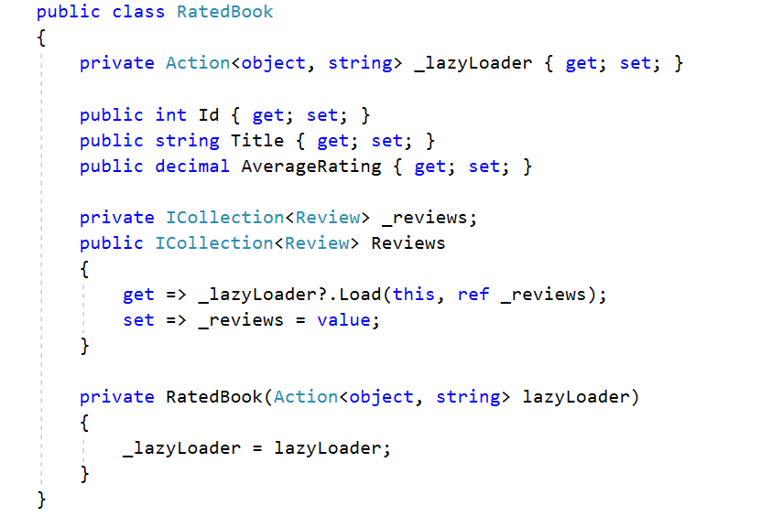
Loading Related data – lazy loading

Slide 29
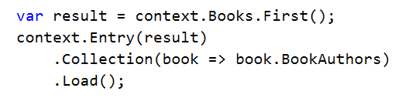
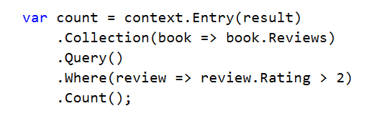
Loading Related data – Explicit loading
Load
Query

Slide 30
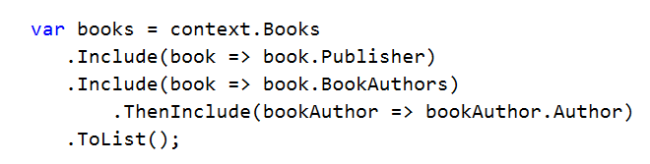
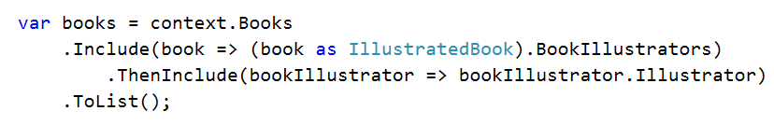
Loading Related data – EAGER loading
Multiple levels
Derived types

Slide 31
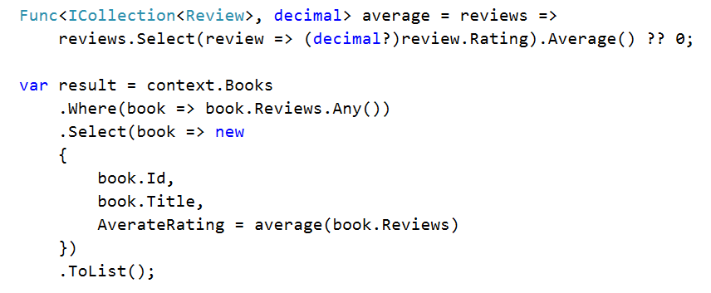
Client query evaluation

Slide 32
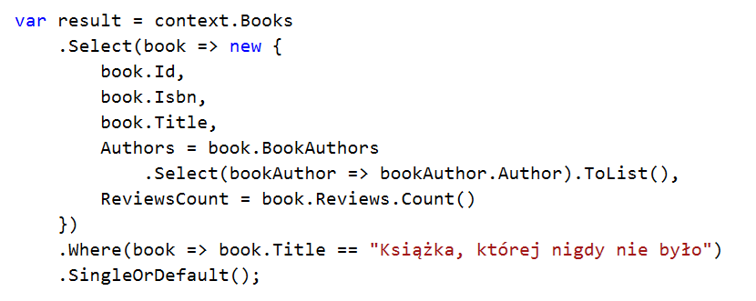
Query optimization
Projections

Slide 33
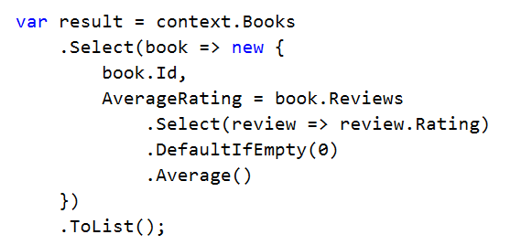
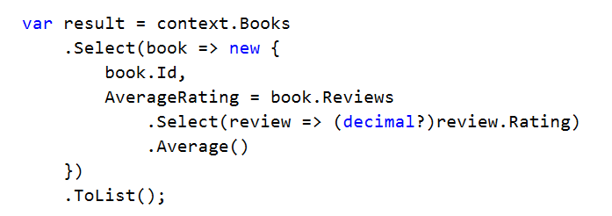
Potential issue: SELECT n+1

Slide 34

Ladder Infographics for PowerPoint
Should I PORT from EF 6 to ef core?

Slide 35
To Migrate or not to migrate
„Because of the fundamental changes in EF Core we do not recommend attempting to move an EF6 application to EF Core unless you have a compelling reason to make the change.”
Microsoft

Slide 36
What’s missing HERE?
Many-to-many without join entity
Inheritance: Table per hierarchy (TPH) only
Mapping to stored procedures
Spatial data
Entity splitting

Slide 37
Ladder Infographics for PowerPoint
Thank you! ☺
e-mail: ags@kmd.dk

